Slide 1
Timothy Seabrook
CDT DPhil Autonomous Intelligent Machines & Systems At: University of Oxford From: Manchester, UK

Slide 2
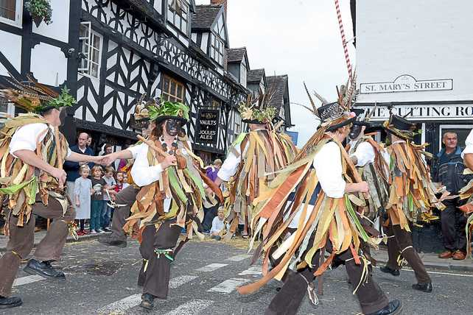

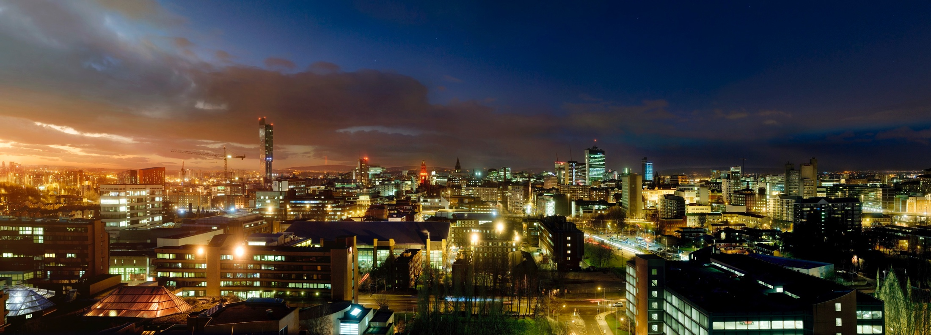
The Story So Far…

Slide 3
Study
Distributed Learning of Dynamic Systems under Guarantees
Formal Logic & Reasoning for Safety and Liveness
Hybrid Systems
Multi-Agent Systems
Reinforcement Learning
Specification Mining
Emergent Social Norms
Other Interests
Computer Vision
System Identification
Robotics

Slide 4
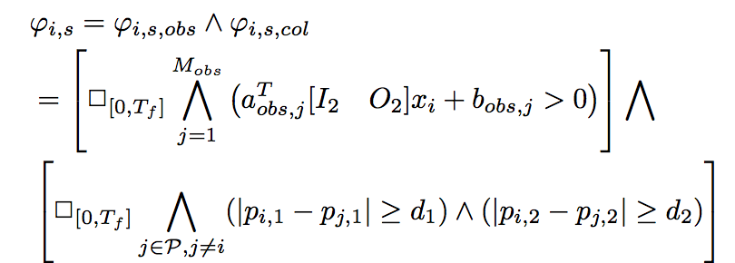
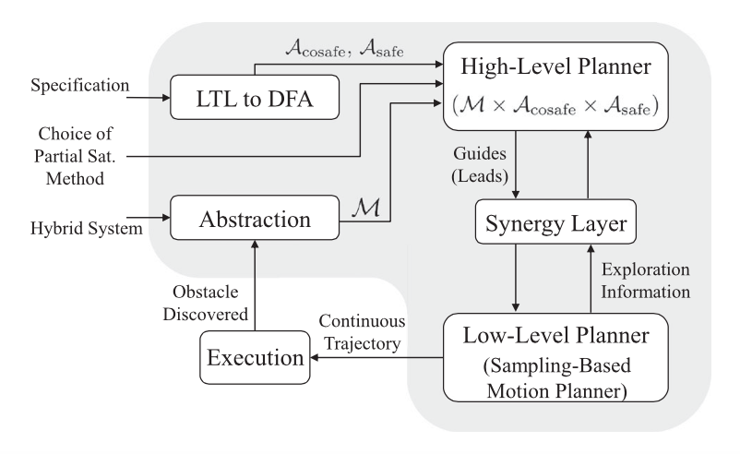
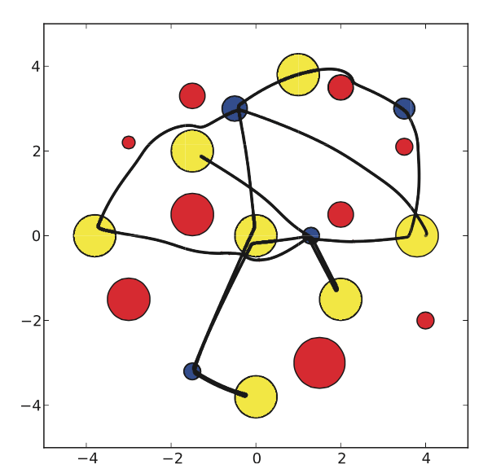
Study

Slide 5
My Superpower
Digesting Ideas and Problem Statements to Develop Solutions

Slide 6
Breakthrough
Accelerating and facilitating a Moon Base
Justification of Mission
Demonstration of Concept
Encouraging first steps toward multi-planetary humanity

Slide 7
Thanks for Listening!

